Slide 1
HOUSING PRICE PREDICTION
Platform - ANACONDA
Programming Language - PYTHON
Dimensions of Data - 23,000 Records
21 Features
Team Members - 4
MODELS & TECHNIQUES USED ACCURACY
Linear Regression (with Outliers) 74.9%
Linear Regression (without Outliers) 80.02%
Decision Tree Regressor 83.5%
XGBoost 85.51%
Random Forest Regressor 88.44%
Gradient Boosting Regression 89.01%

Slide 2
INDEX
OUR OBJECTIVE
IMPORTING LIBRARIES & LOADING DATASET
EXPLORING DATA
LINEAR REGRESSION (WITHOUT TREATING OUTLIERS)
LINEAR REGRESSION (AFTER TREATING OUTLIERS)
DECISION TREE REGRESSION
XGBOOST
RANDOM FOREST REGRESSION
GRADIENT BOOSTING REGRESSION
CROSS-VALIDATION SCORES

Slide 3
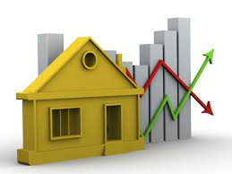
OUR OBJECTIVE
A Real estate company that runs a website for buying and selling of houses, they would like to give the customers a prediction of the cost of the houses in a few years.
We have to use the housing data,we have to pre-process it, and have to create a model that will predict the price of the house and will measure the accuracy of the model.in a few years. We used the housing data, pre-processed it, and created a model that was predicting the price of the house and measured the accuracy of the model

Slide 4
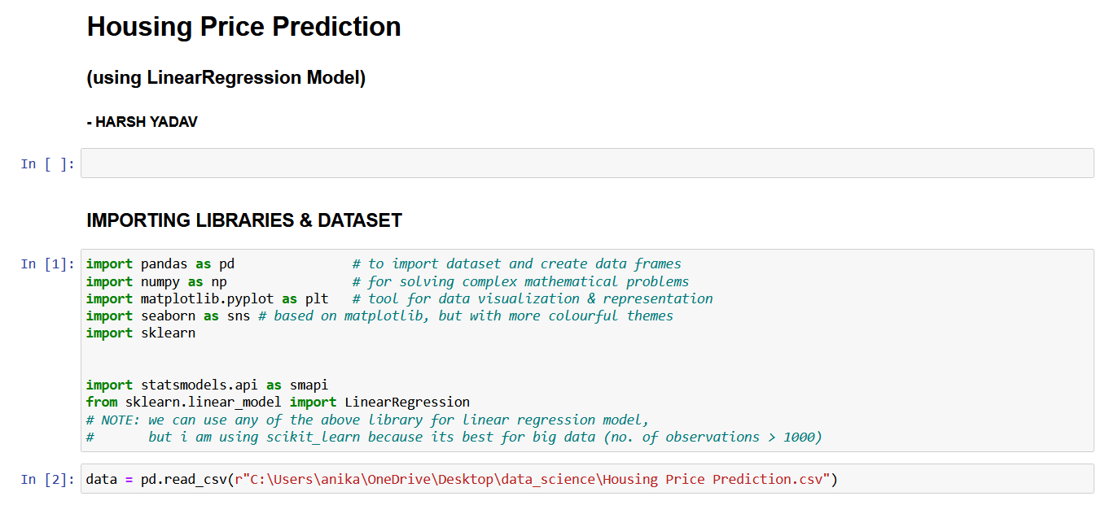
IMPORTING LIBRARIES

Slide 5

EXPLORING DATA

Slide 6
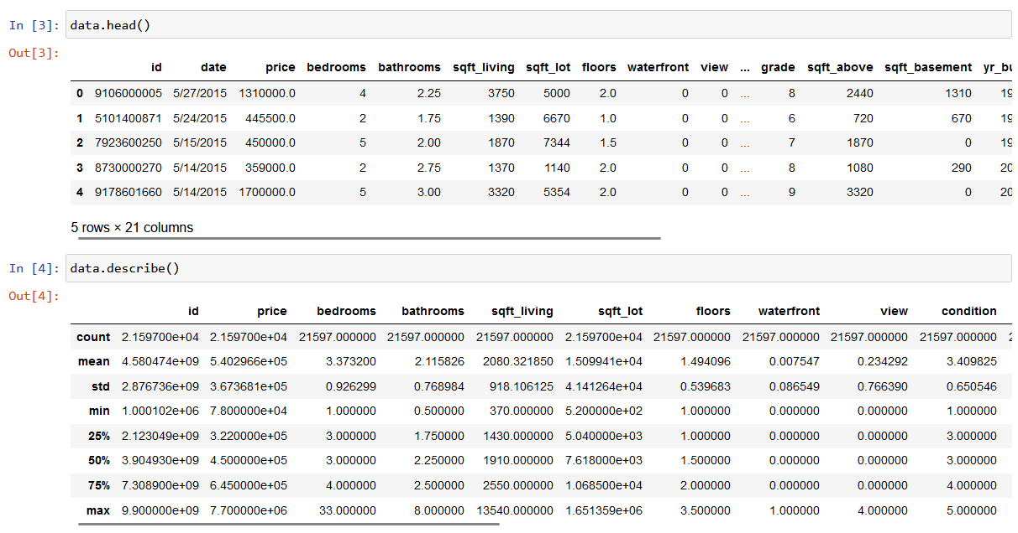
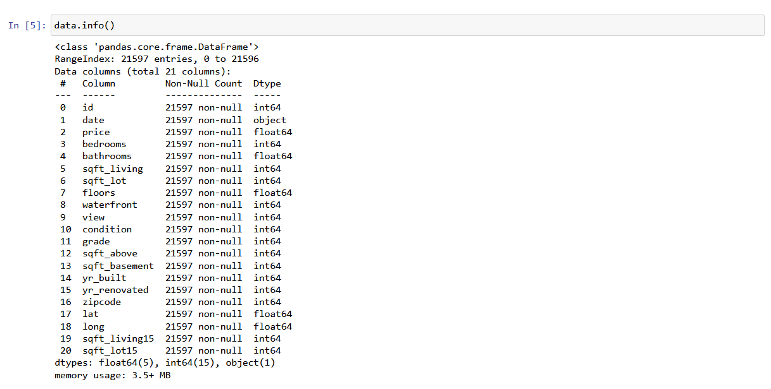
EXPLORING DATA

Slide 7
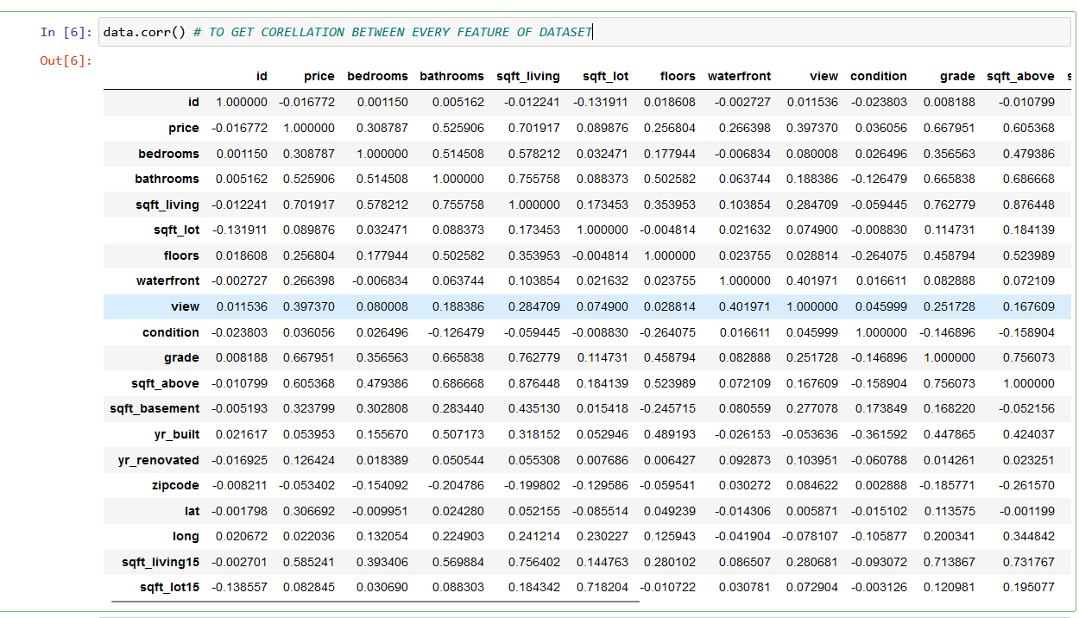

Slide 8
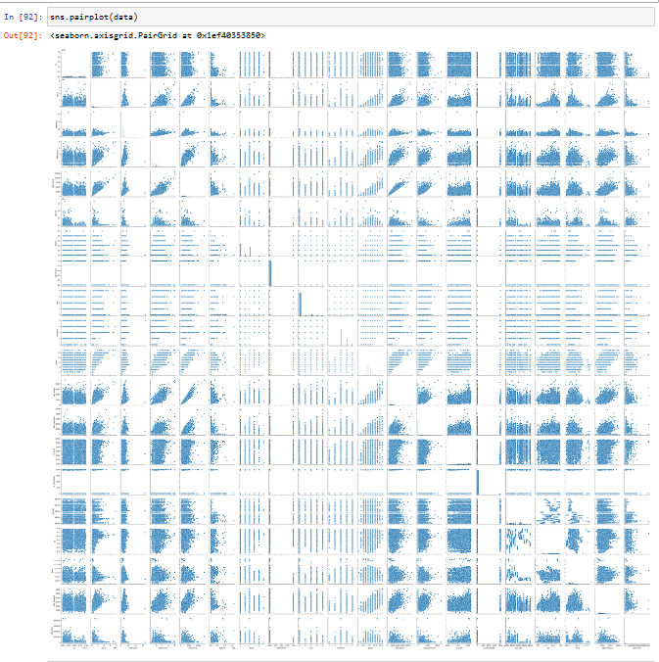

Slide 9
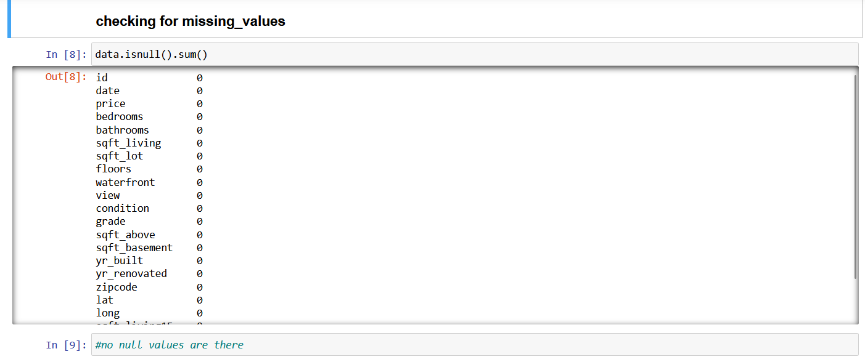

Slide 10
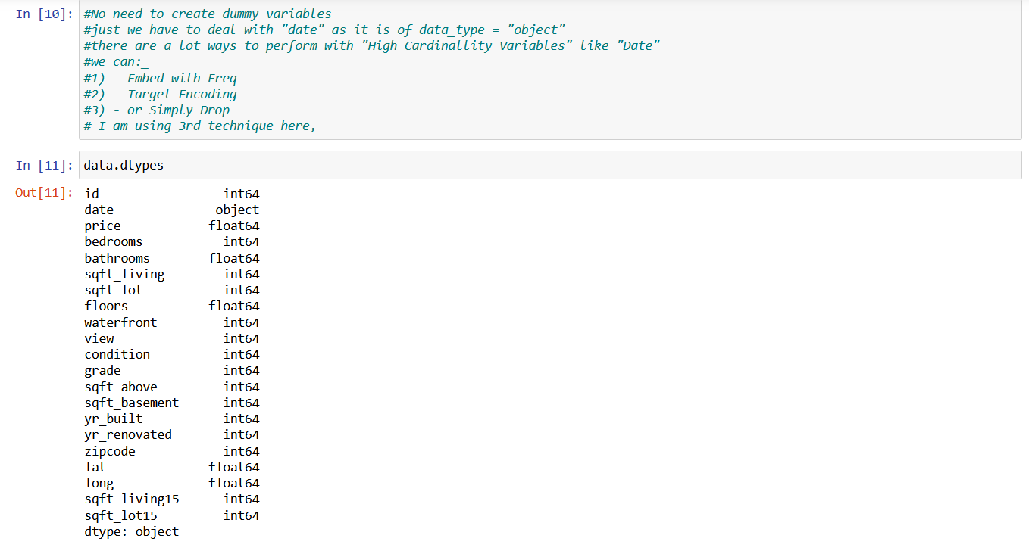

Slide 11
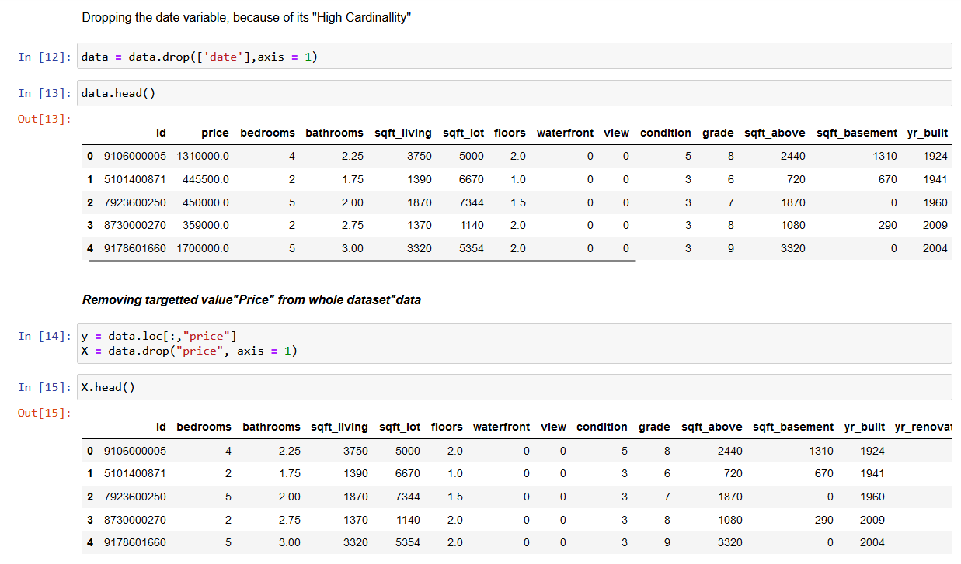

Slide 12
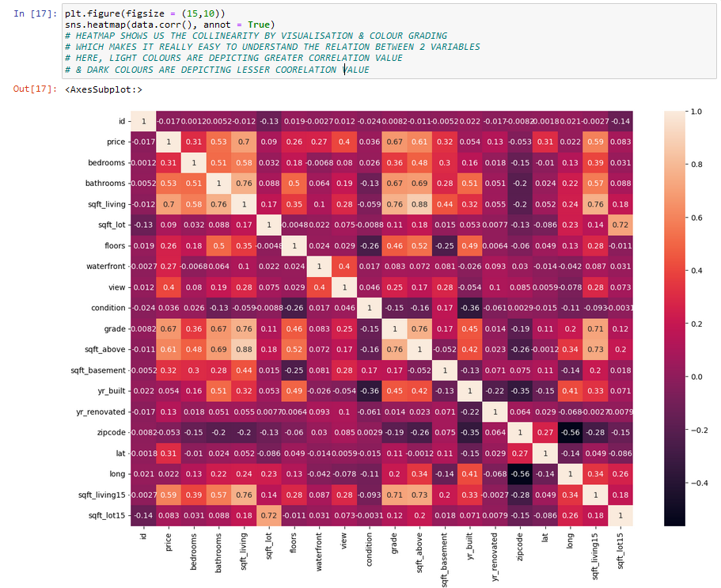

Slide 13
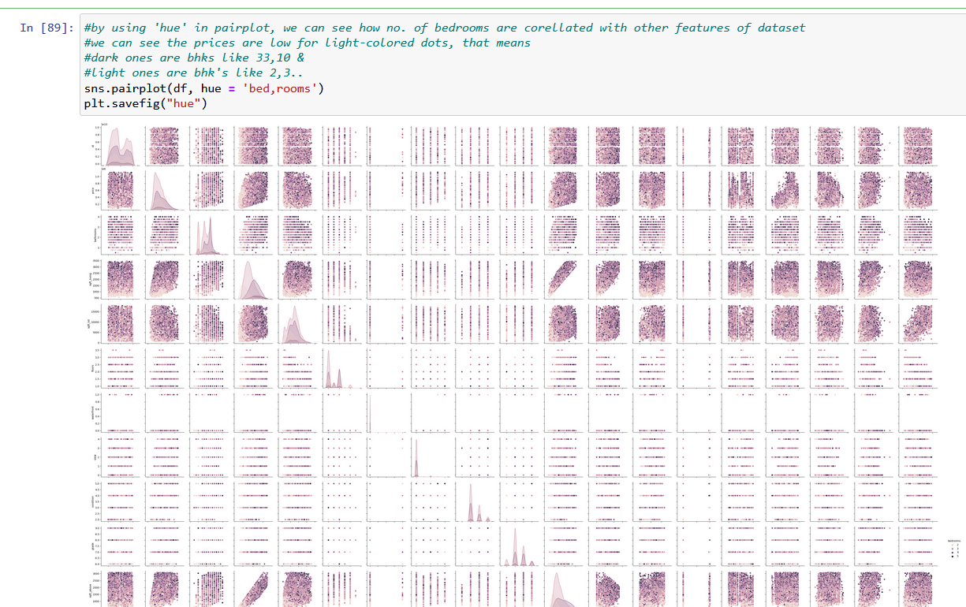

Slide 14
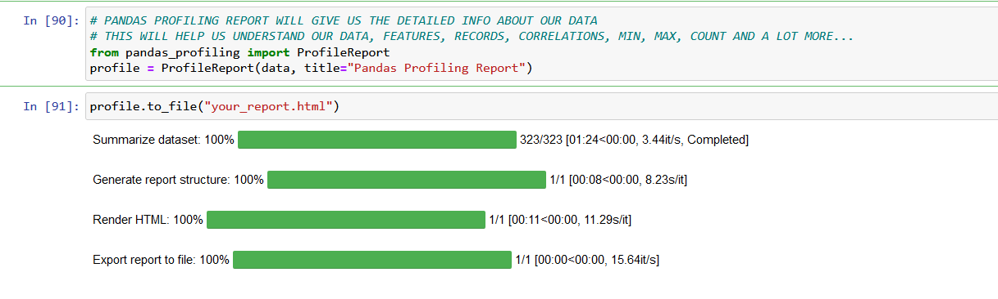

Slide 15
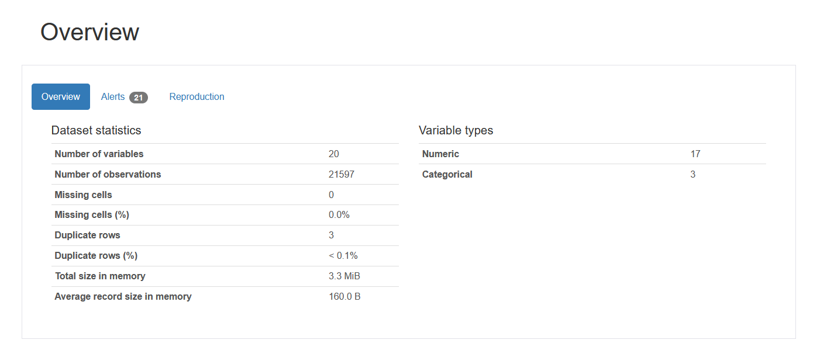
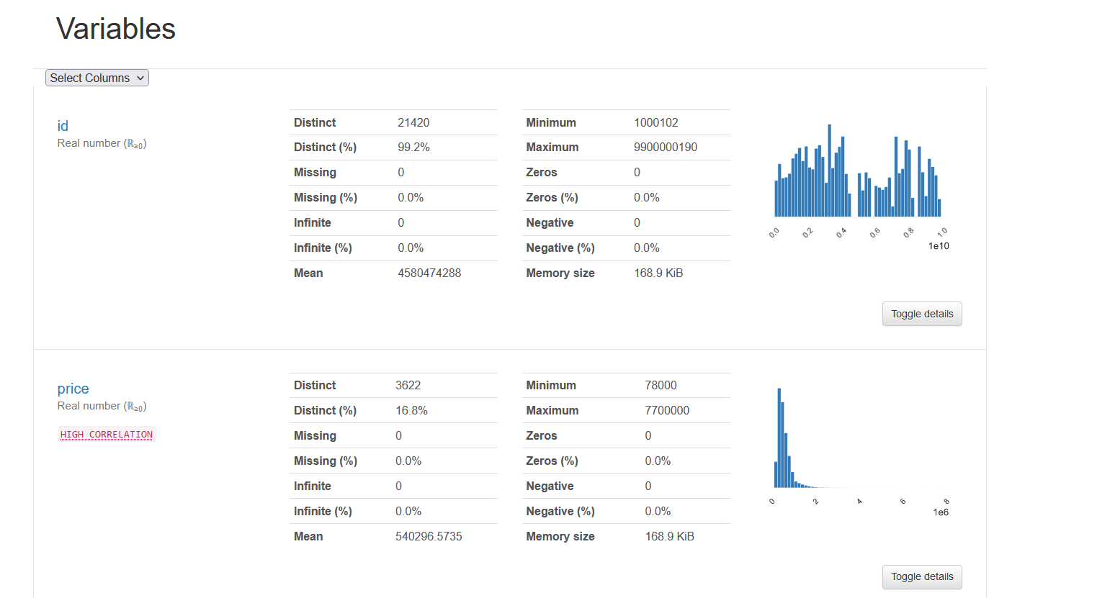
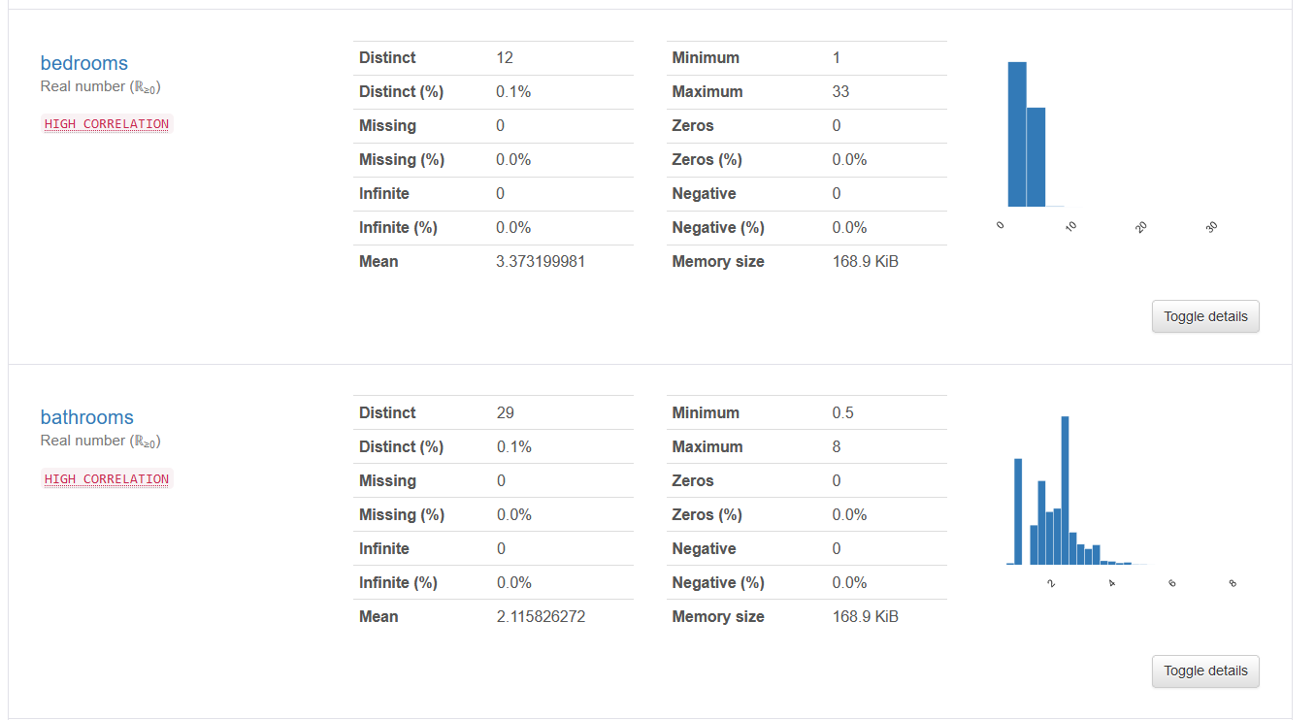
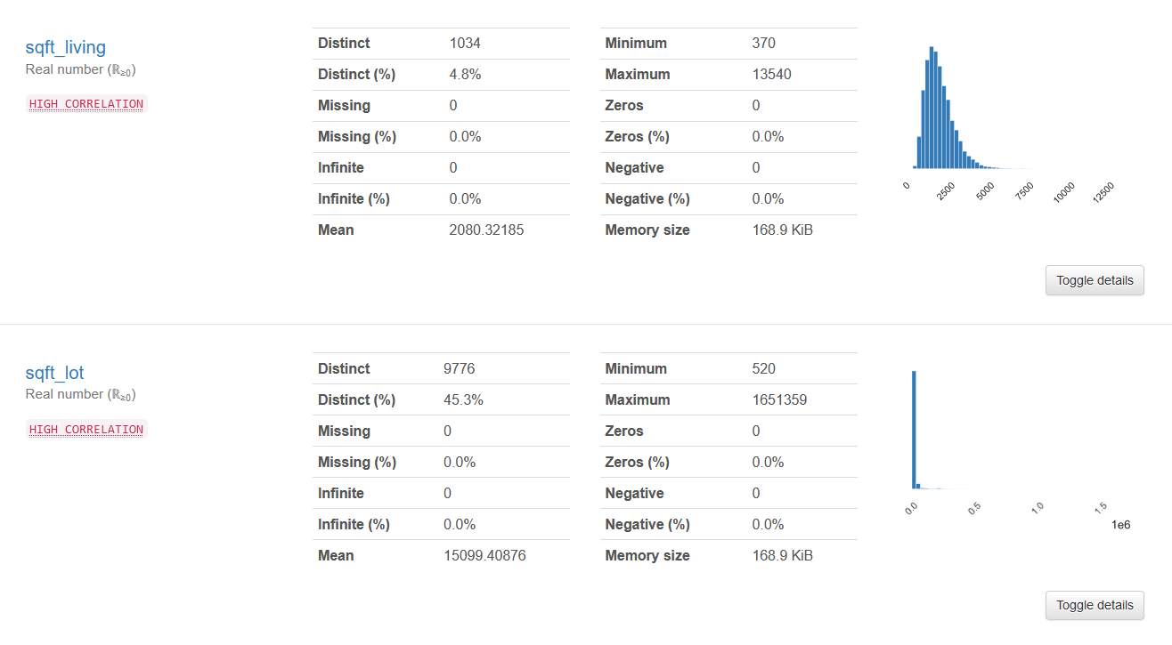

Slide 16
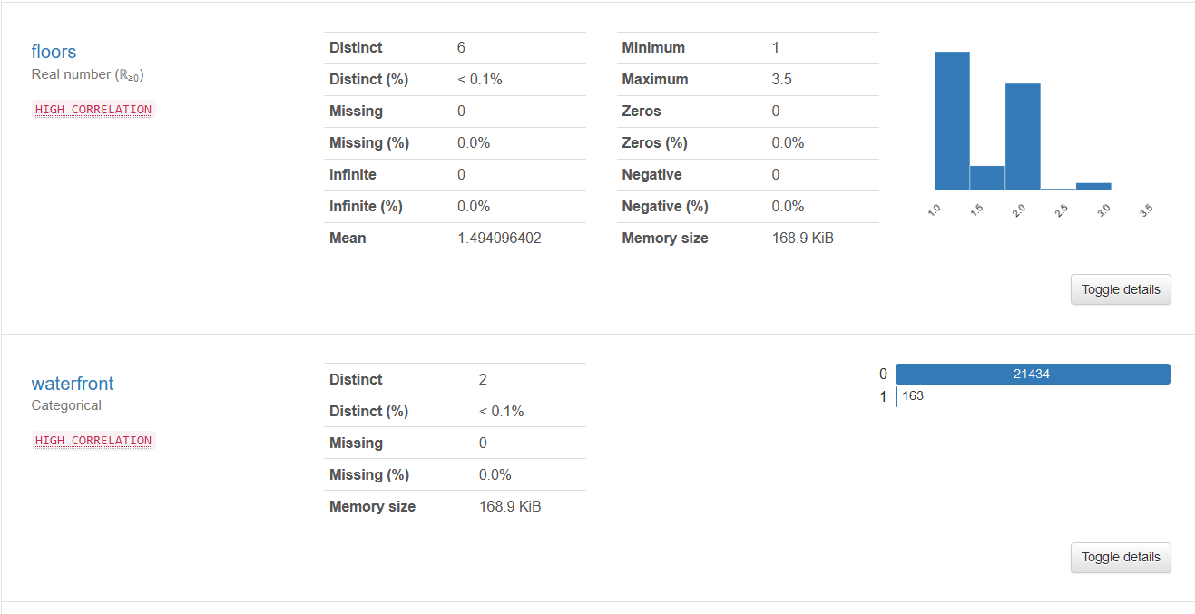
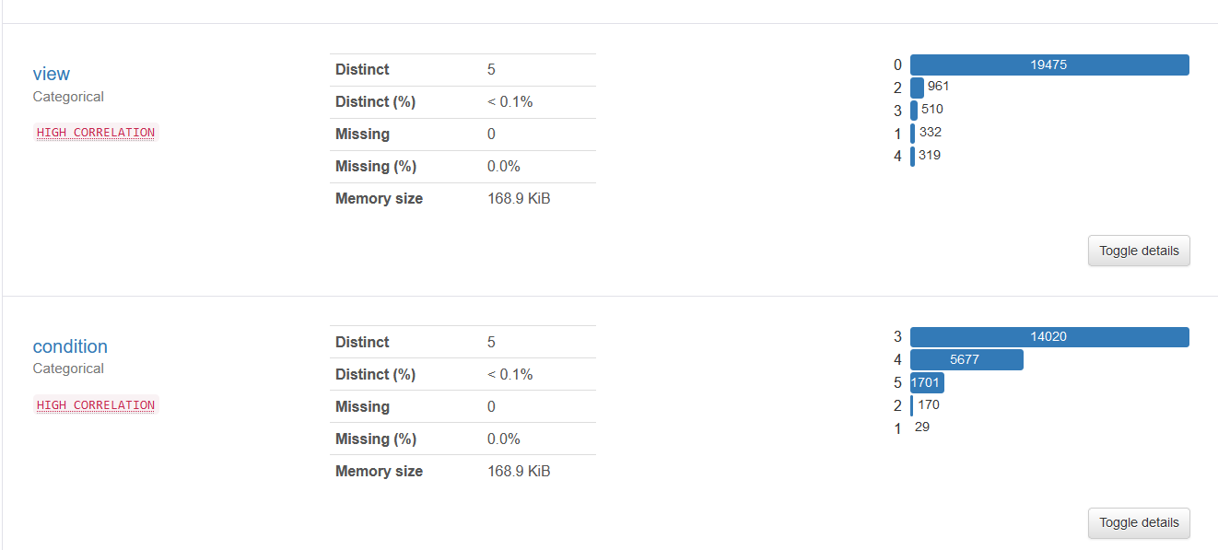
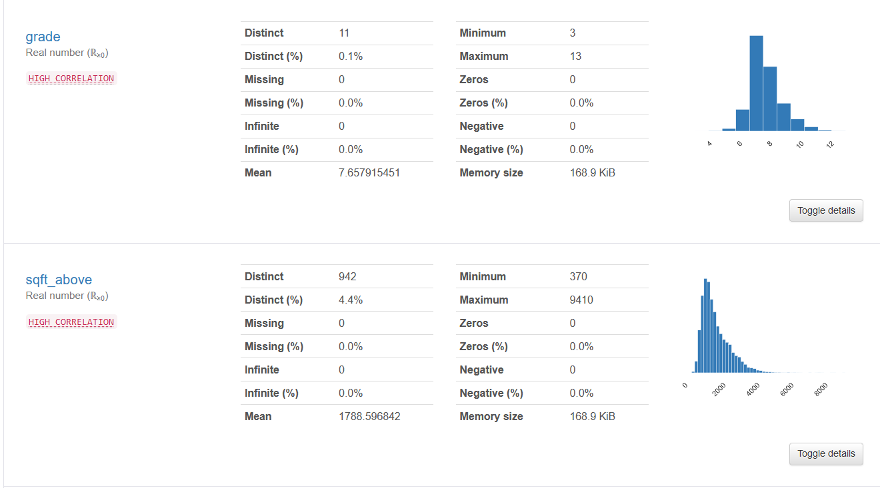
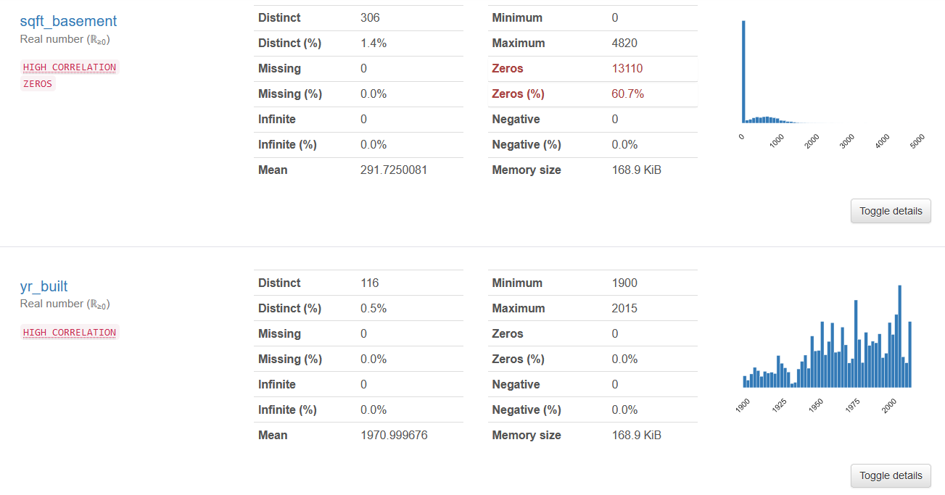

Slide 17
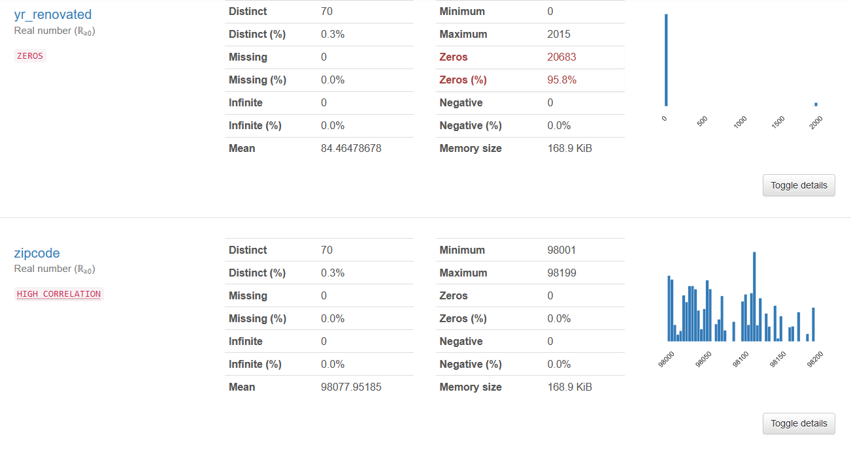
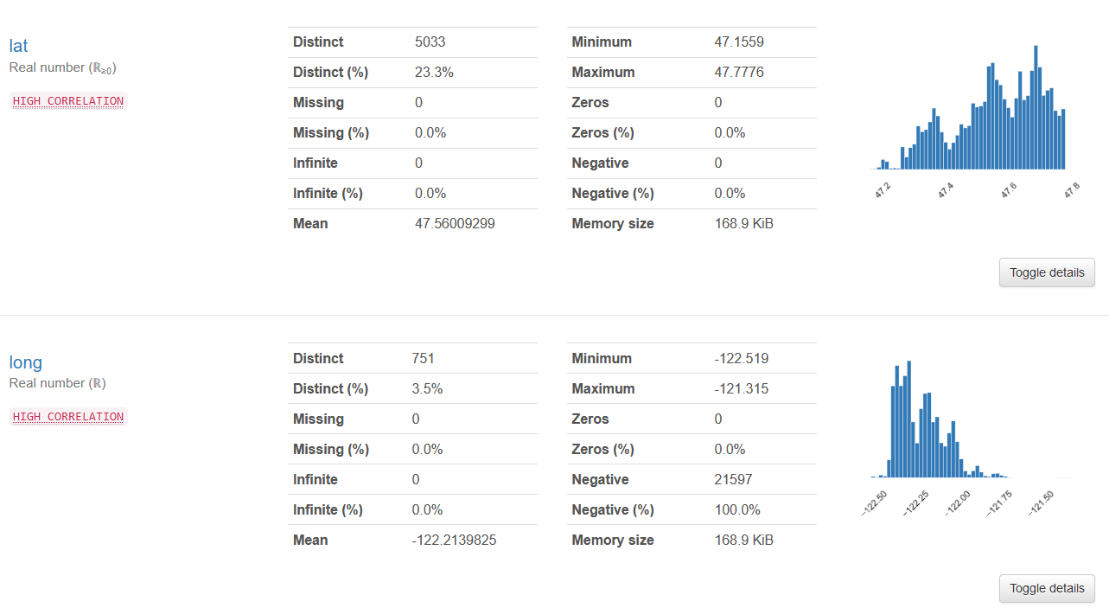
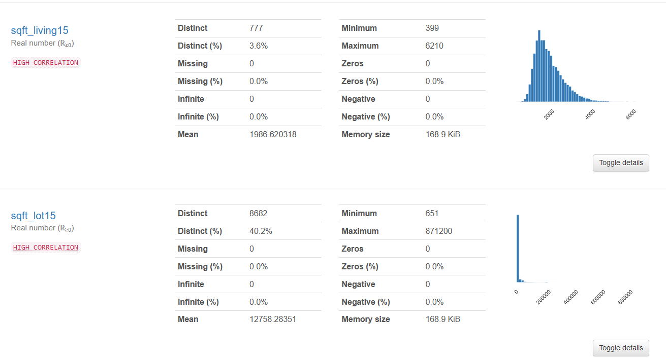

Slide 18
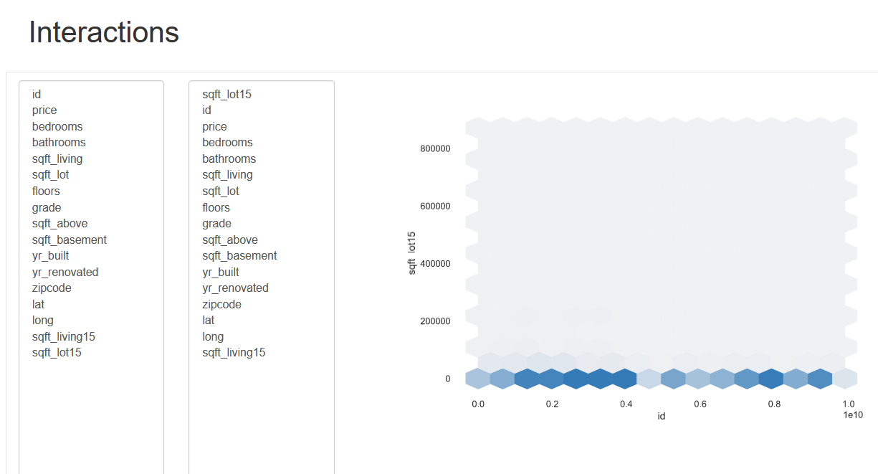
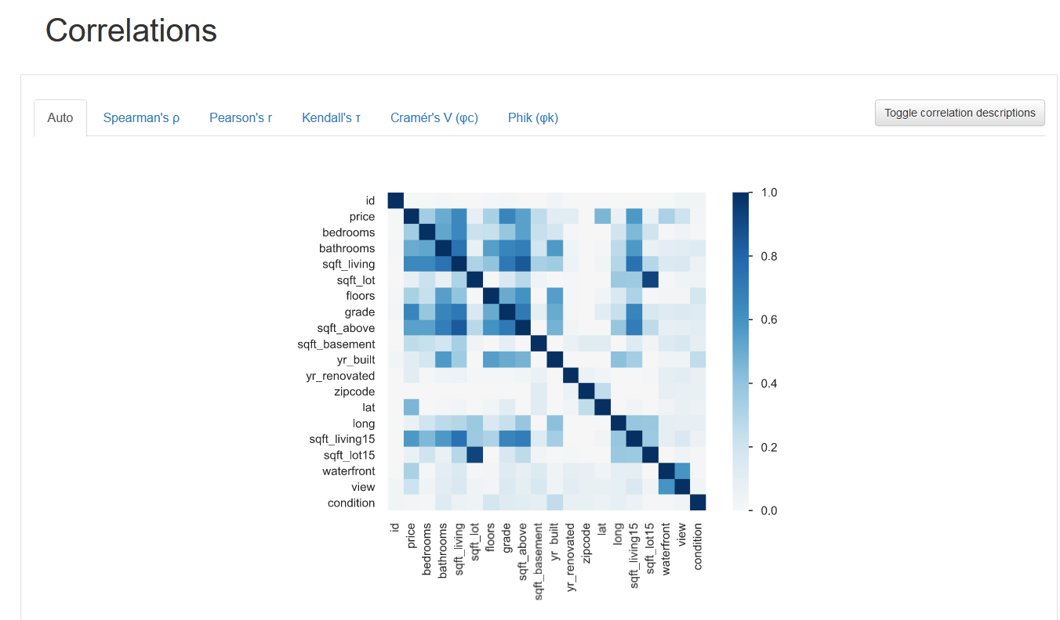
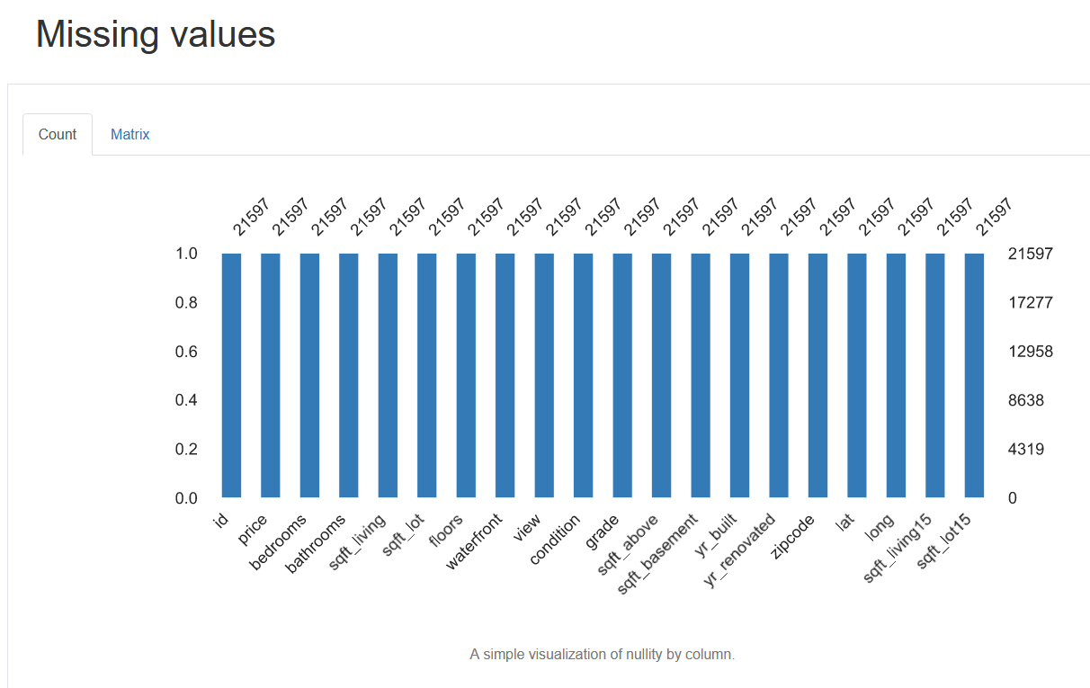
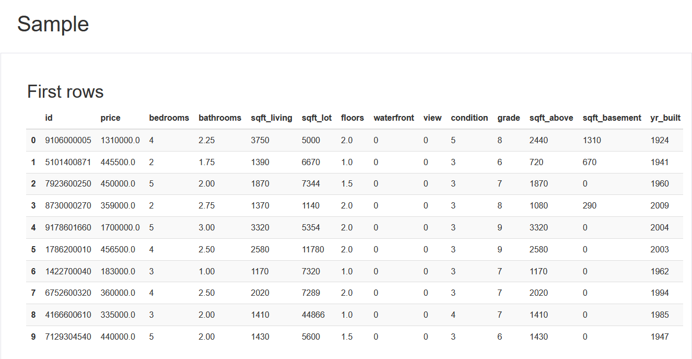

Slide 19
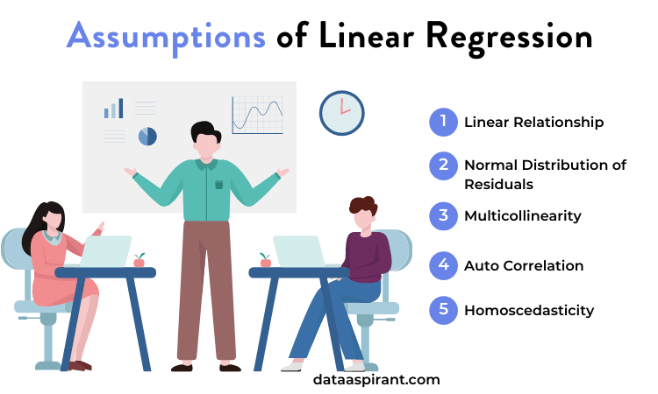
LINEAR REGRESSION (WITHOUT TREATING OUTLIERS)

Slide 20
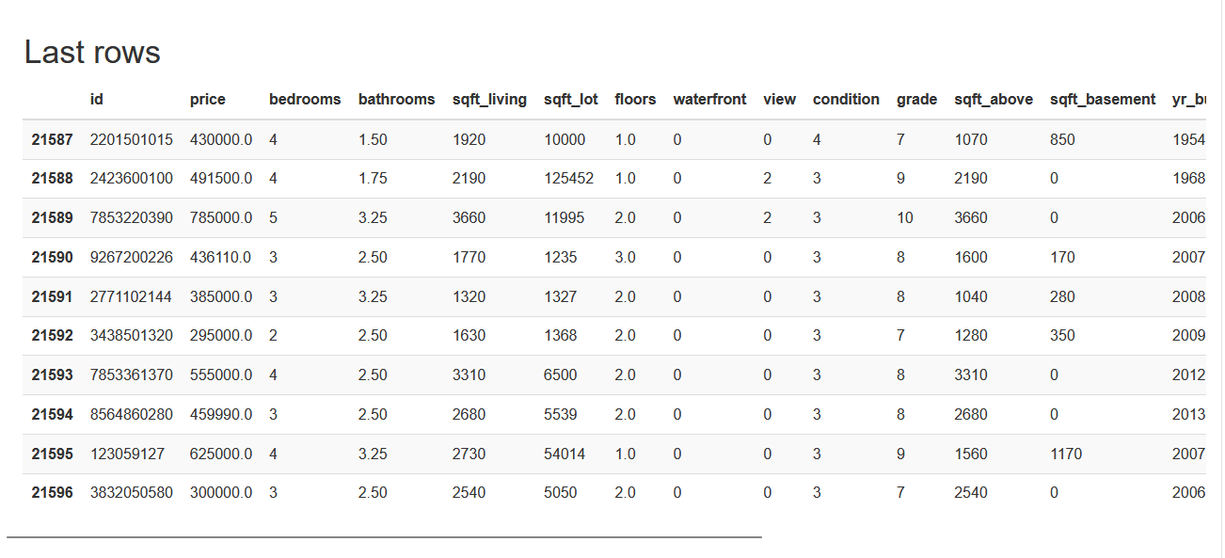
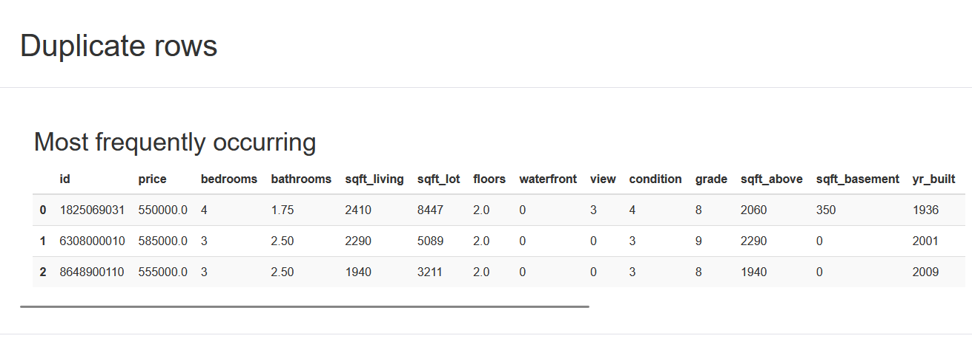

Slide 21
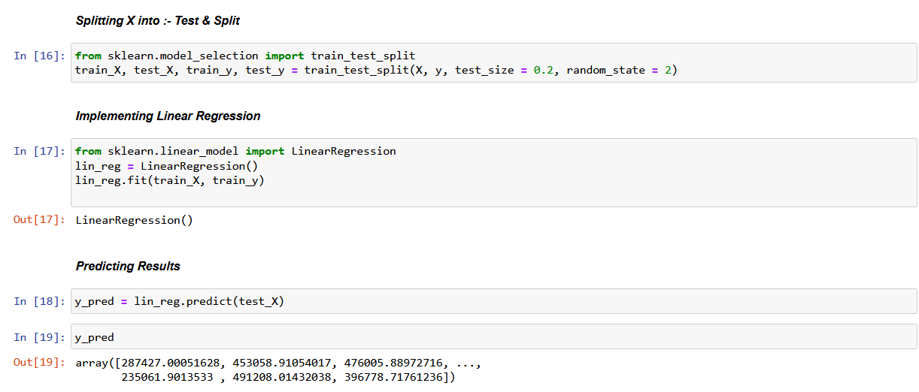

Slide 22
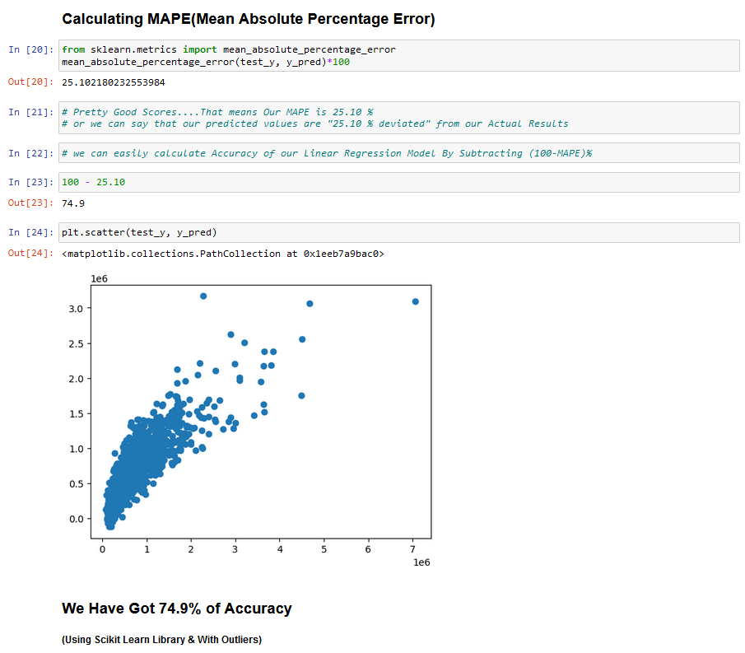

Slide 23
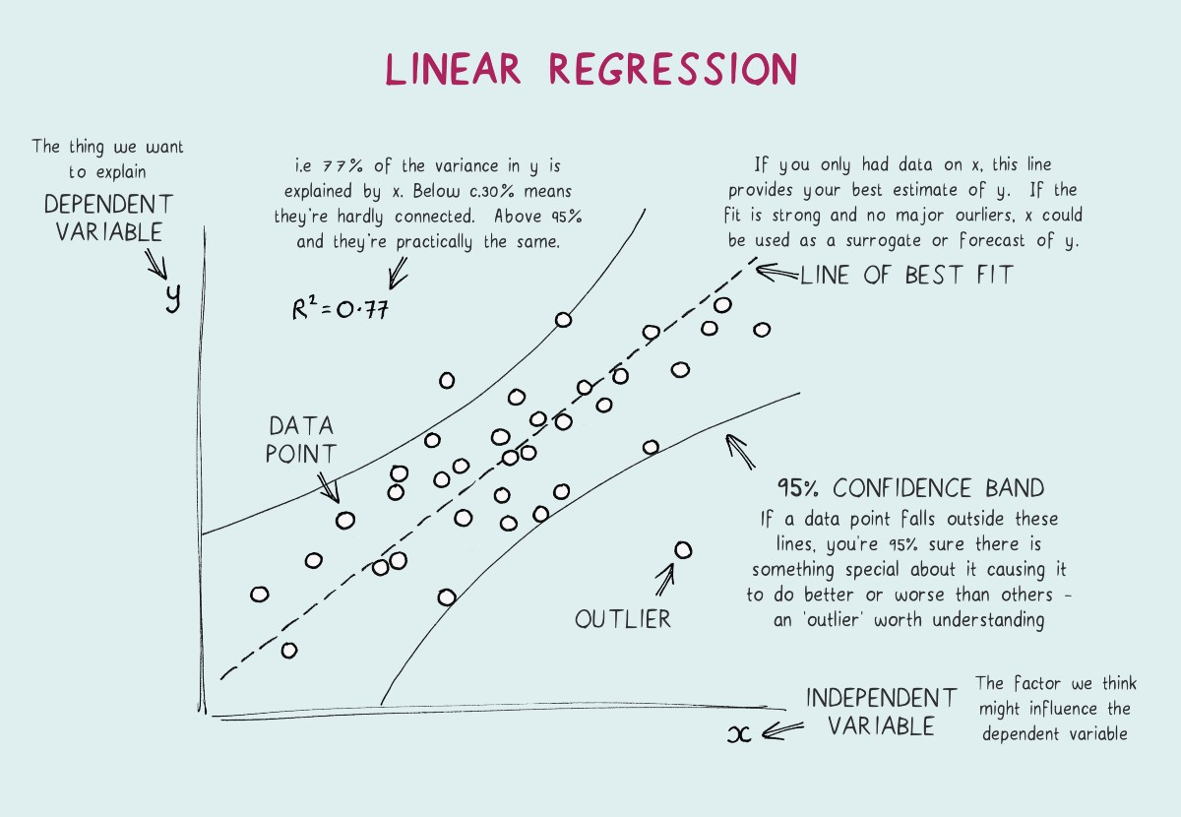
LINEAR REGRESSION (AFTER TREATING OUTLIERS)

Slide 24
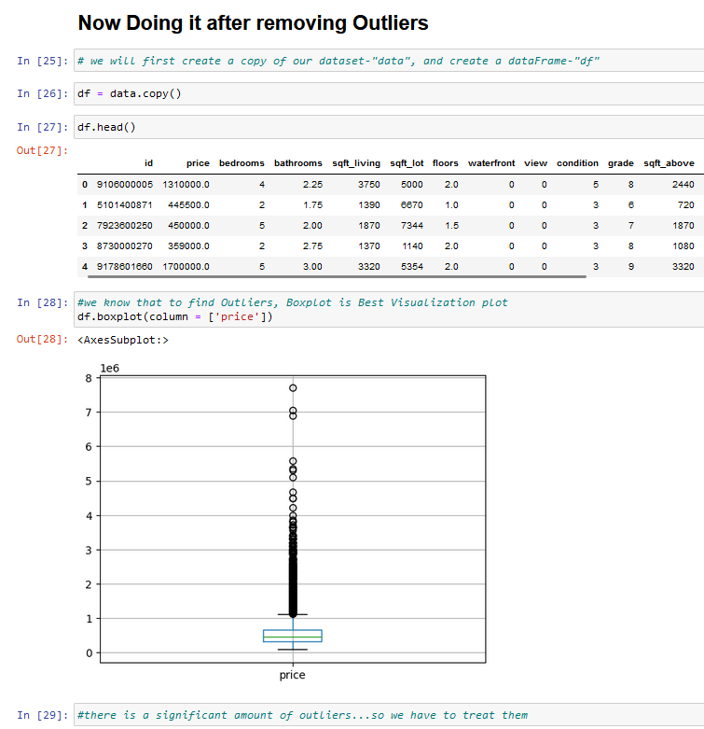
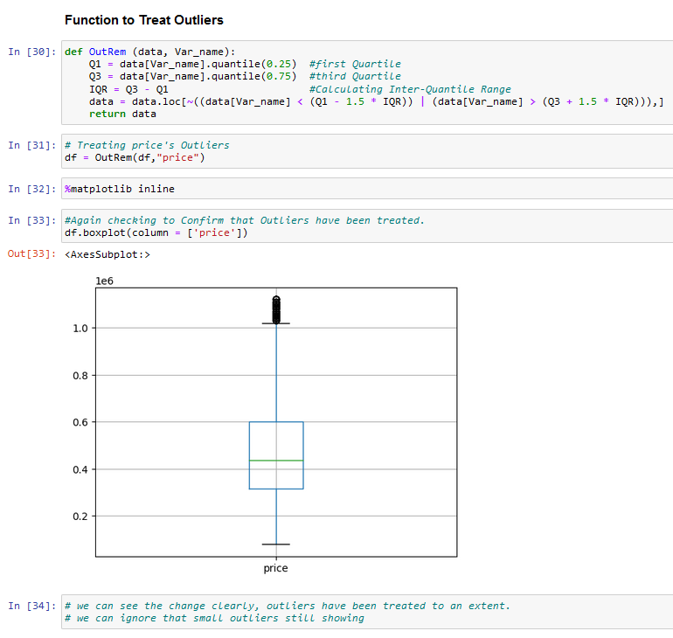

Slide 25
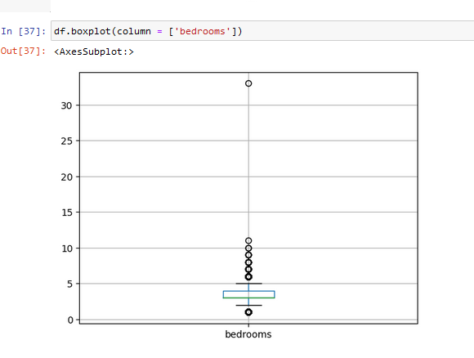
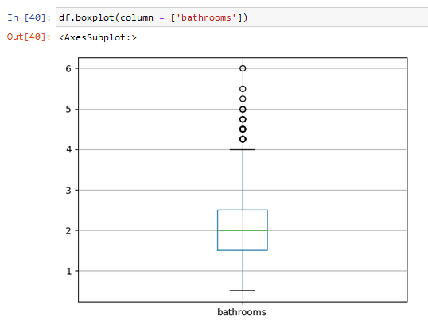
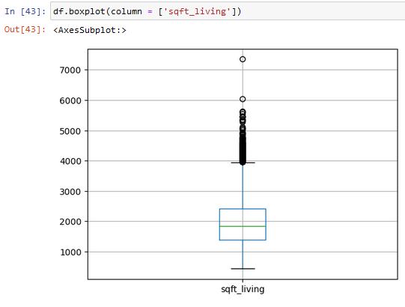
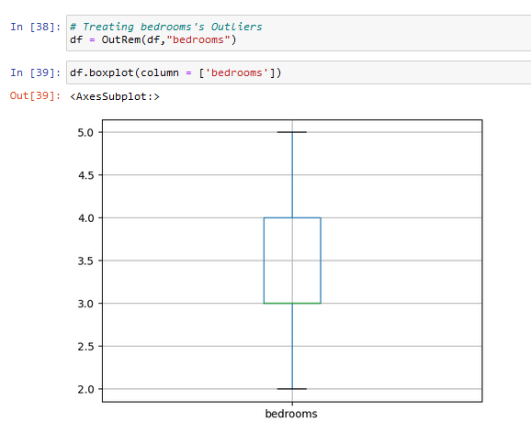
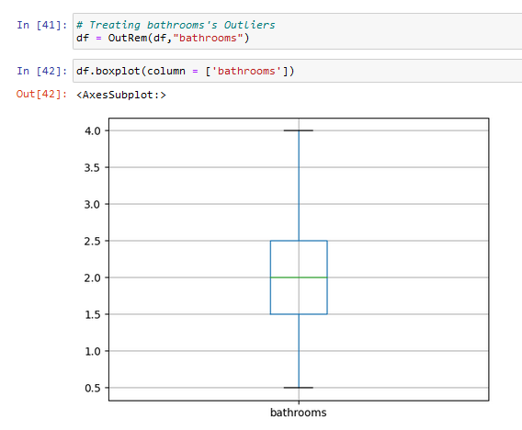
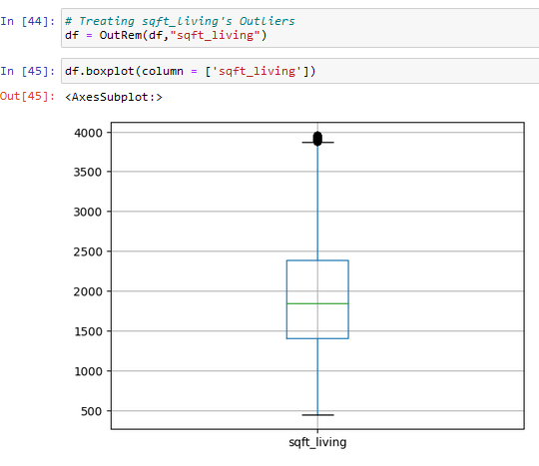

Slide 26
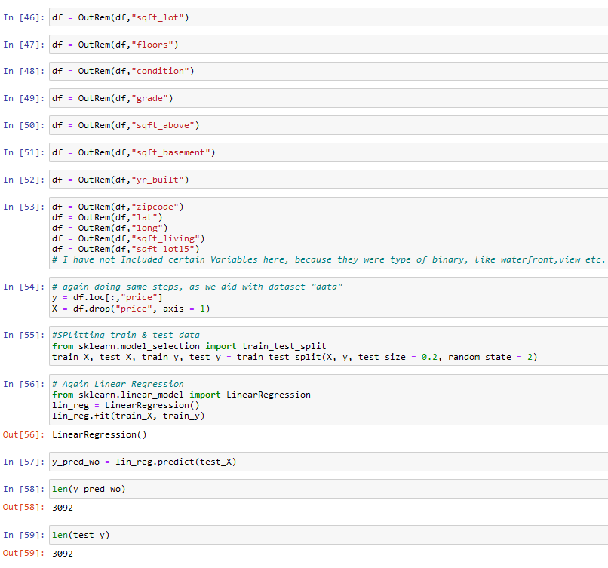

Slide 27
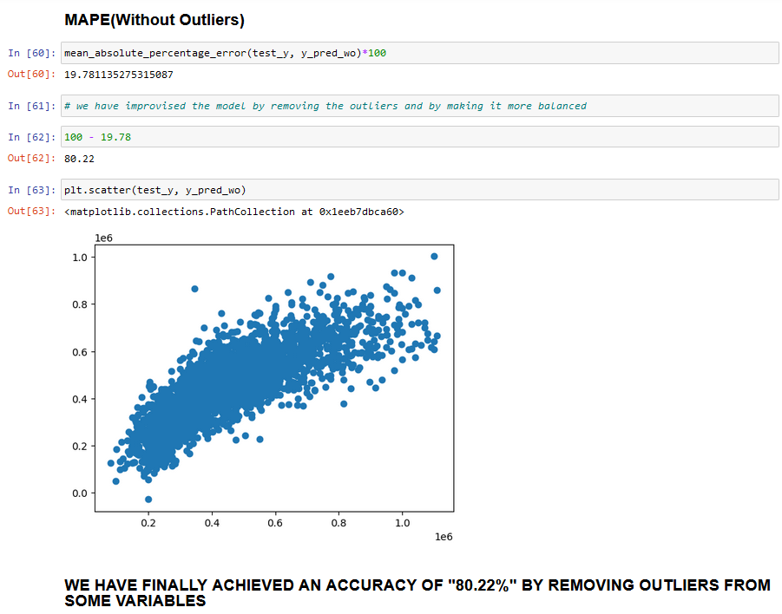

Slide 28
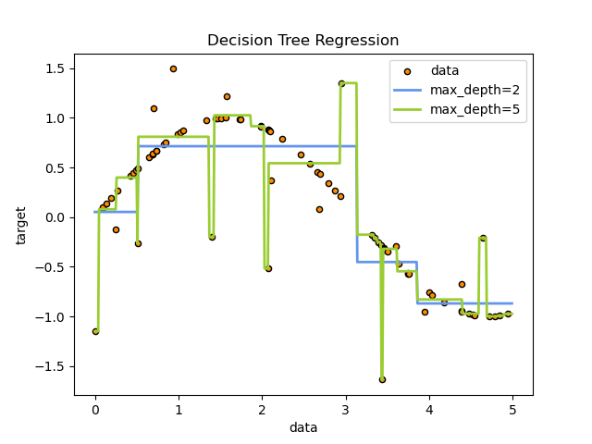
DECISION TREE REGRESSION

Slide 29
